Slide 1
Lymphoedema Surgery
Liposuction at Macquarie University, Sydney 2015

Slide 2
Background Info.
Developed primary lymphoedema in left leg in 2012 at 19 y/o, no injury/accident or family history
Began treatment including multi-layer bandaging, laser treatment, compression garments, manual lymphatic drainage, kinesio taping, physiopod machine (explained on next slide)
Started researching possible surgical options 2014
Had surgery 15 December 2015 in Sydney

Slide 3
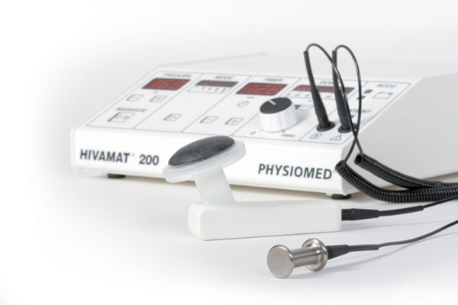
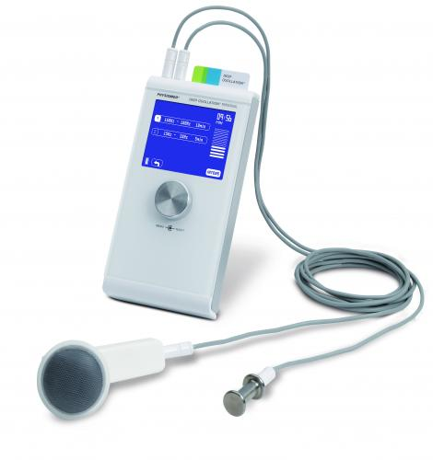
Information about PhysioPod machine
DEEP OSCILLATION® is an internationally patented, proven technology based on the effects of creating an electrostatic field in the tissue of the patient. Easy application is from therapist to patient/client via hygienic, vinyl gloved hands; utilizing all normal massage movements or via circular movements over the tissue with a handheld applicator. The handheld applicator also enables self-treatment
The special structure of DEEP OSCILLATION® allows the creation of biologically effective oscillations in the treated tissue using electrostatic attraction and friction. In contrast to other therapies, these pleasant oscillations have a gentle and deep-acting effect on all tissue components to an 8 cm depth (through skin, connective tissue, subcutaneous fat, muscles, blood and lymph vessels).
Because of the non-invasive, non-traumatic, gentle nature of this therapy, very early possibilities of application are possible following injury and from Day One post operatively. Chronic conditions can also be worked upon with effective results.
The following physiological effects of DEEP OSCILLATION® are clinically proven:
Highly effective in reducing pain
Anti-inflammatory
Effective in reabsorbing oedema (swelling)
Encouraging wounds to heal
Fibrosis Reduction
Improving trophicity
Rubor reduction (haematoma/bruising)
Detoxification
Improving quality of tissue
http://www.physiopod.co.uk

Slide 4
Brief overview: Surgical options
Lymphatic Venuous Anastomosis
Supermicrosurgery performed in Oxford, UK
By connecting functioning lymphatics to veins, the fluid can drain into the venous system and out of the affected lymph, bypassing wherever there is a blockage in the system
Oxford Lymphoedema Practice http://olp.surgery/professionals/evidence

Slide 5
2. Lymph Node Transfer
Dr Corinne Becker who pioneered the surgery in Paris
Patients with hypoplastic lymphatics are preferred candidates (not enough as opposed to too many lymphatic channels)
Involves taking healthy lymph nodes from elsewhere in the body, in my case from underarm and replacing what appear to be damaged lymph nodes in groin
http://www.lymphoedemacenter.com/

Slide 6
3. Liposuction at MacQuarie University Hospital
24/7 management using compression tight follow the procedure
MacQuarie Criteria for selection for Liposuction:
1. Late stage lymphoedema with fatty change and minimal fluid in the limb
2. Completed and complied with conservative treatment
3. An arm-volume difference of 750–1000 ml (or arm ratio above 1:1.3) and a leg-volume difference of greater than 3000ml
4. The lymphoedema limb must be causing problems such as heaviness or difficulty in use such that a patient wants something done
5. No recent cellulitis (infection)
6. No skin lesions or ulcers in the limb
7. No evidence of active cancer
8. No surgical or anaesthetic contraindications for liposuction
9. Patient must be prepared to attend follow up and wear compression garments as instructed, replacing them when needed
10. Patient must be prepared to undergo a surgical procedure with anaesthetic and to stay at Macquarie University Hospital for up to 10 days and be available for follow up over a 12-month period
11. Patient must not be obese, and have weight (minus limb extra weight) in normal range for height (calculated BMI < 27)
http://muh.org.au/Services-Specialties/Lymphoedema-Program/Liposuction

Slide 7
Macquarie University Hospital
Pre-operative photos December 2015
Followed by a week of multi-layer bandaging

Slide 8
The Surgery + Recovery
4 ½ hours
3.5 L of fat removed
3-4 days in hospital, I spent 7
Mt Wilga Rehabilitation centre to ensure you can put new custom made garment on yourself
Incisions healed within 2 weeks
Back in NZ 15 days later

Slide 9
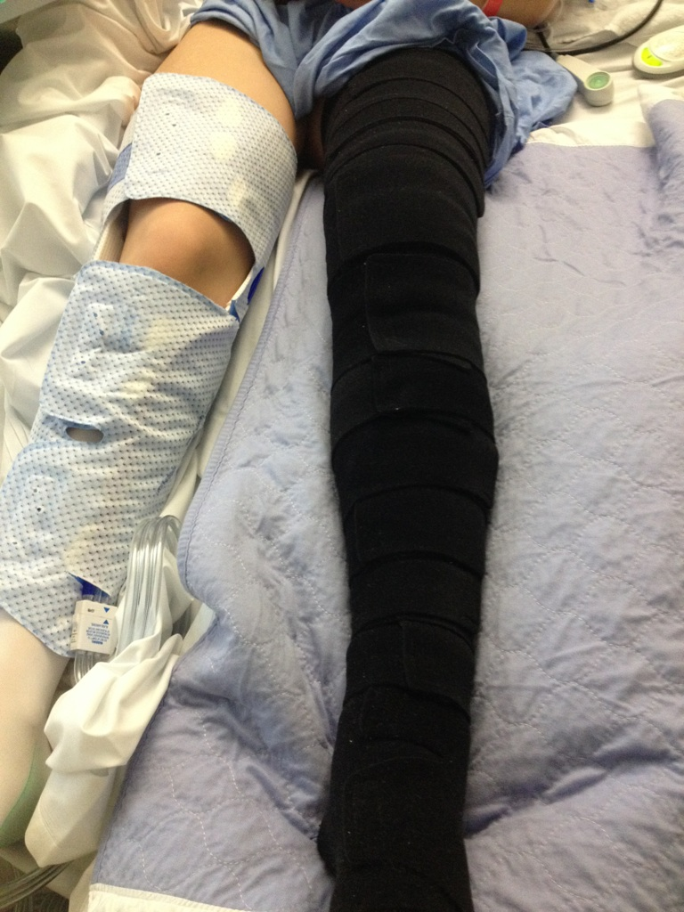
Post-op pictures
1 day →
← 2 days

Slide 10
Funding
Have medical aid so initially applied to insurers. They required that we apply to the DHB first
DHB Application: put together all the medical reports that we had since 2011 + letter giving the history of my case and explanation of what they were offering in Sydney + letter from Macquarie saying that I would be a good candidate.
Our GP sent all of these documents as well as his referral to the DHB. After some time I received an appointment time to see the lymphoedema specialist at the DHB.
Basically the DHB decide on a case by case basis whether to apply to the Ministry of Health in Wellington for approval for funding for high cost overseas procedures. They do an application to the MOH on the recommendation of their specialists.
Ministry of Health agreed to fund the procedure

Slide 11
Ankle Break Jan 29 2016
Just over 1 month post-op fell through rotten deck board and broke ankle on lymphoedema leg in 3 places
7 weeks in moon boot with ready wraps for compression

Slide 12
3 months post op

